Slide 1
Cybersecurity
Adware and Spyware

Slide 2
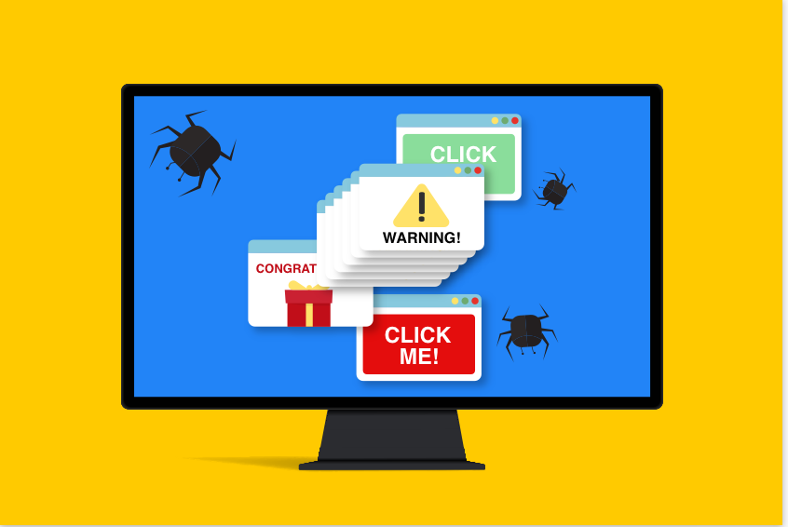
Adware
Computer becomes a billboard for your eyes
Pop-ups on top of pop-ups
May slow your computer
Creates network traffic
May have accidentally installed
May be bundled with some software
Be leery of software that claims to remove adware
Especially from a pop-up!

Slide 3
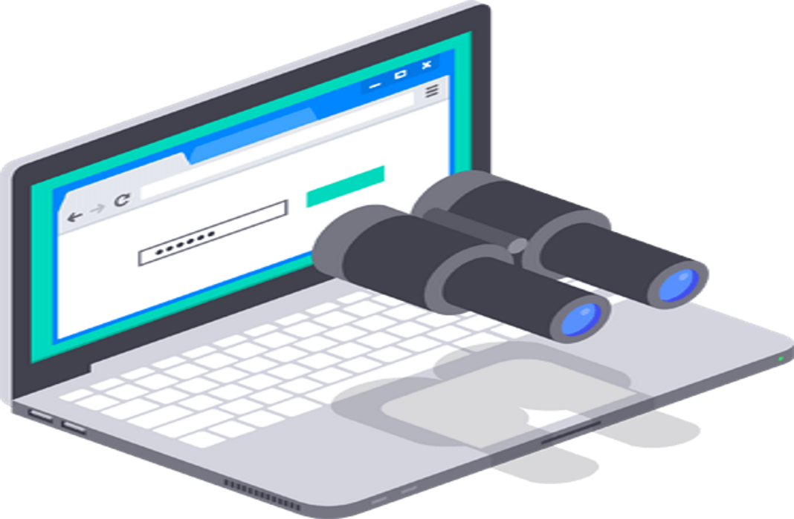
Spyware
Malware that watches you
Advertising, identity theft, fraud
May trick you into installing
Fake security software
Browser monitoring
Captures and reports surfing habits
Keyloggers
Capture every keystroke
Send it back to hackers

Slide 4
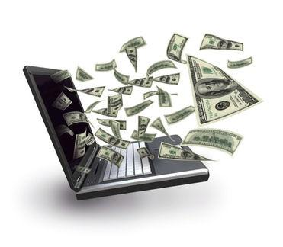
Reason
Money
Money
Money
Advertisers pay for “impressions” (views)
Pay more for “click throughs” (even accidental/fraudulent)
Your data and habits are worth money
Your financial information is worth money
Even if you don’t think you’re rich
A little money from a lot of people adds up!

Slide 5

Protecting against adware/spyware
Update anti-virus/anti-malware
Know what you’re installing
Watch your installation options
Keep system backup
You might need it someday
Cleaning adware isn’t easy
Run malware scans
e.g. Malwarebytes

